Slide 1
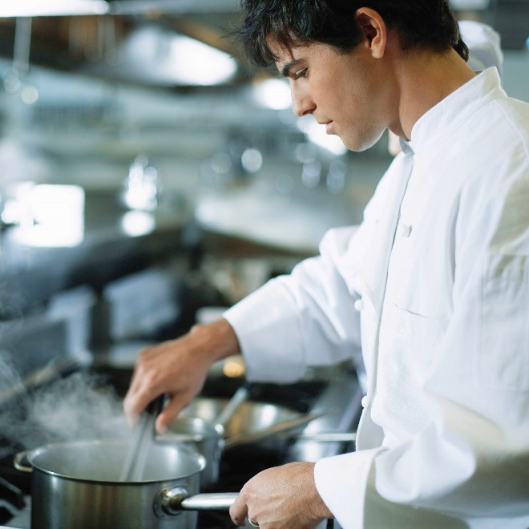
COOKING RICE
Basic Methods

Slide 2
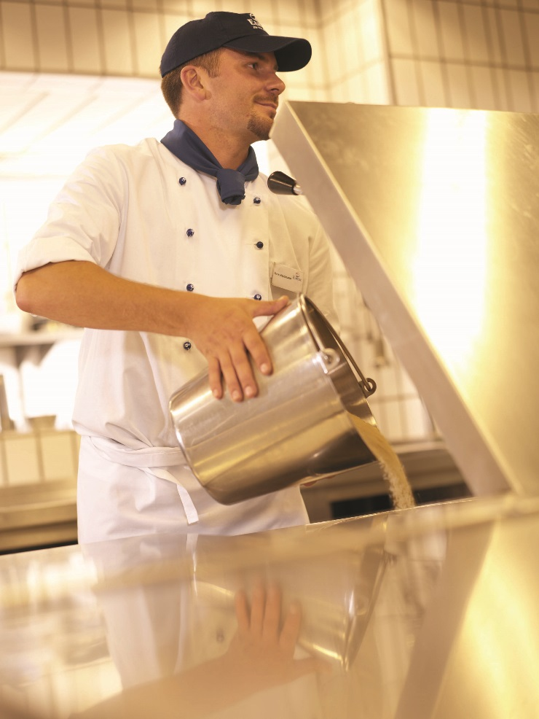
RICE IN FOODSERVICE
Ideal flavor carrier for traditional and global dishes.
Essential ingredient in foodservice kitchens, usually stocked in bulk.
Professional chefs need to know the basics of preparing rice & train kitchen staff on the fundamentals.

Slide 3
ORDERING RICE
Rice Type or Form | Common Pack Size
White Rice | 25, 50 or 100 lb.
Parboiled | 25 or 50 lb.
Whole Grain Brown | 25 or 50 lb.
Precooked (Instant) | 25 lb.
Aromatic (U.S. jasmine, U.S. basmati) | 25 lb.
Seasoned Rice Mixes | 6/36 oz. boxes/case or 12/28 oz. boxes/case

Slide 4
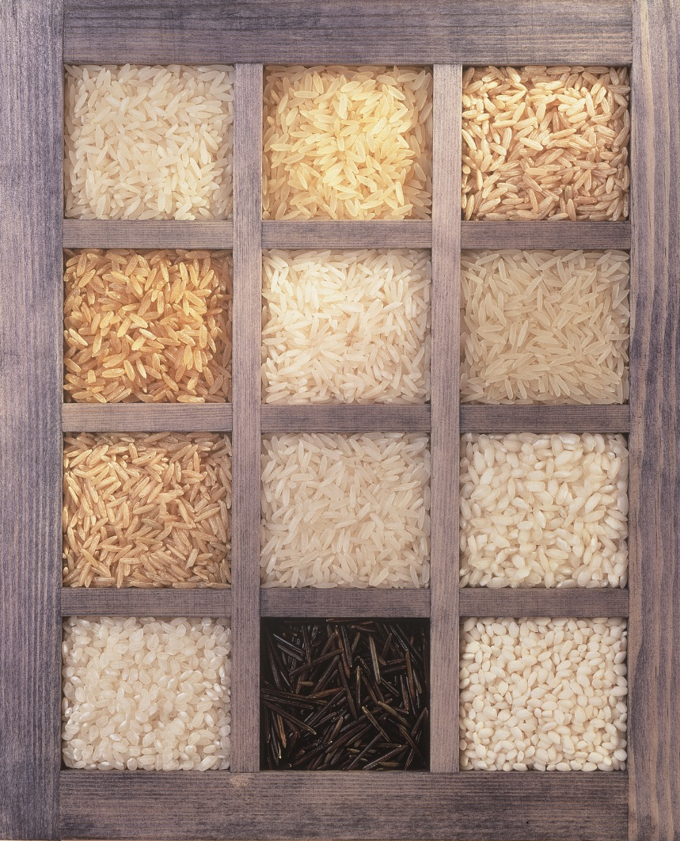

TIPS FOR ORDERING RICE
Use a supplier you trust for best selection and highest quality.
Choose the type(s) of rice best suited to your menu and desired results.
Know the origin of products you order.
    Look for the “Grown in the USA” logo to ensure high quality rice from U.S. farmers

Slide 5
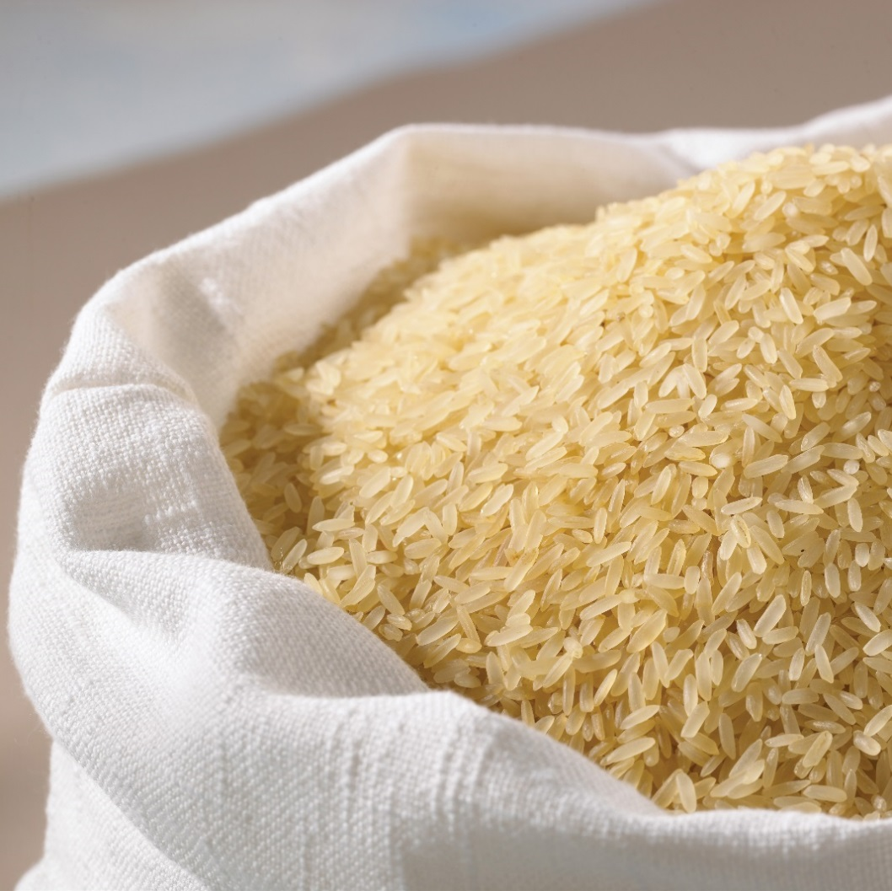
STORING UNCOOKED RICE
Keep in a dry, cool environment in tightly sealed, waterproof containers.
White rice will last almost indefinitely; rotate supply regularly for best quality.
Whole grain brown rice has about 6 month shelf life, or up to 1 year if refrigerated.
Avoid storing rice next to foods with strong aromas.

Slide 6
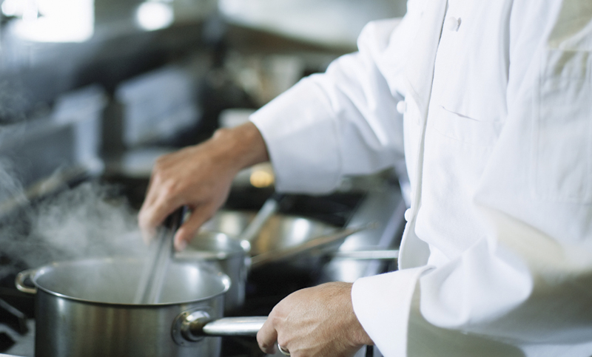
CHOOSING THE BEST COOKING METHOD
Consider:
  Type and form of rice you are using.
  Recipe and desired finished dish.
  Cooking equipment available.
  Time available.
  Skill level of kitchen staff.

Slide 7
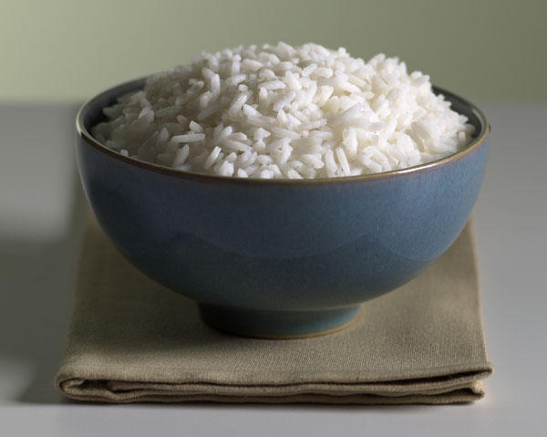
PROPORTION OF LIQUID TO RICE
The key to preparing perfectly cooked rice!
Most methods call for cooking rice
in a measured amount of liquid.
  General rule of thumb is: 2 to 1*
  2 parts liquid to 1 part rice by volume
* Important: Different types of rice require slightly less or slightly more liquid. Check package instructions to verify the ratio for best results.

Slide 8
RICE COOKING GUIDE
Approximate liquid ratios and cooking times
Rice Type | Parts liquid to 1 part rice (by volume) | Cooking time (minutes)
Long grain white | 2 | 15-18
Medium grain white | 1 ½ | 15-18
Short grain white | 1 ¼ | 15-18
Parboiled | 2 ¼ | 20
Parboiled brown | 2 ¼ | 25
Medium or long grain brown | 2 ¼ | 40-45
U.S. jasmine | 2 | 15-18
U.S. basmati | 2 | 15-18
U.S. arborio | 4 | 20-30
Wild rice | 3 | 40-50
Seasoned rice mixes | Follow package directions | Follow package directions

Slide 9
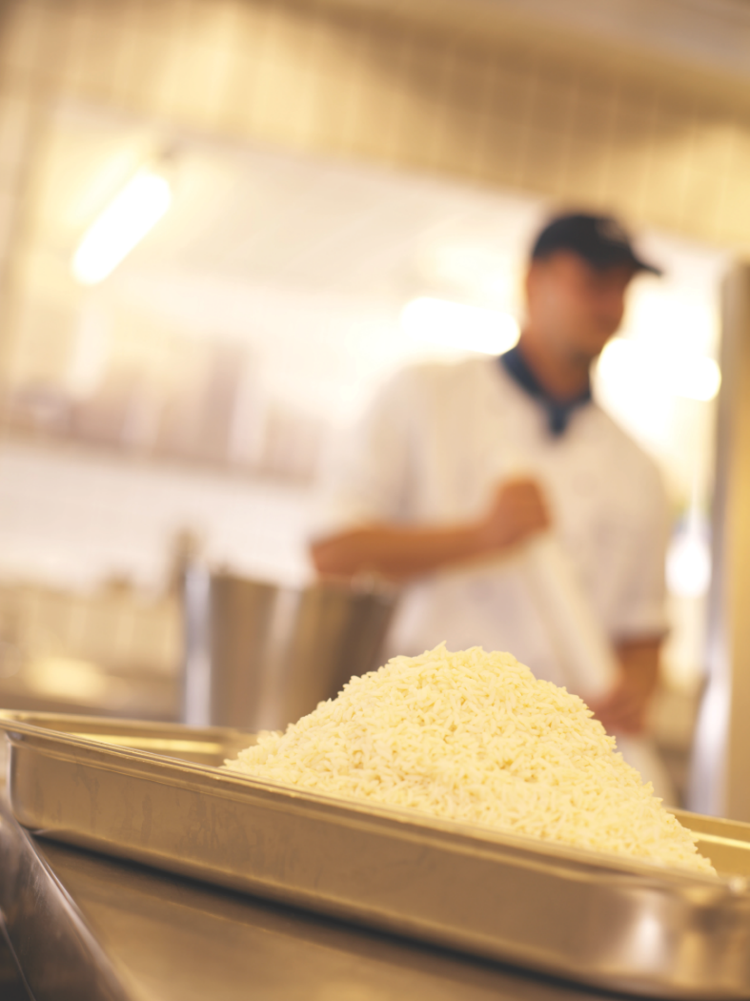
DETERMINING YIELD
Dry rice typically triples in volume during cooking.
  Ex: 1 cup dry rice = 3 cups cooked rice
  1 quart dry rice = 3 quarts cooked rice
Dry rice more than doubles in weight during cooking.
  Ex: 1 pound dry rice = 2+ pounds cooked rice

Slide 10
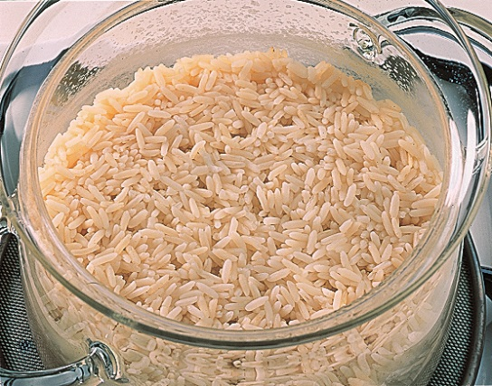
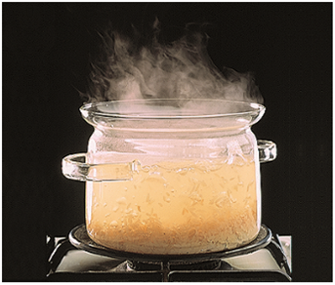
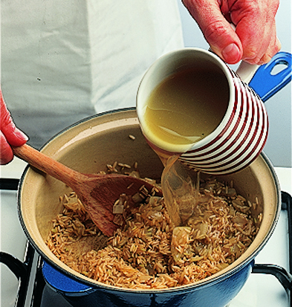
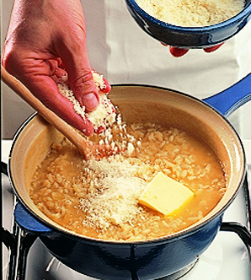
BASIC METHODS FOR COOKING RICE
Simmering/Steaming
Boiling
Pilaf
Risotto

Slide 11
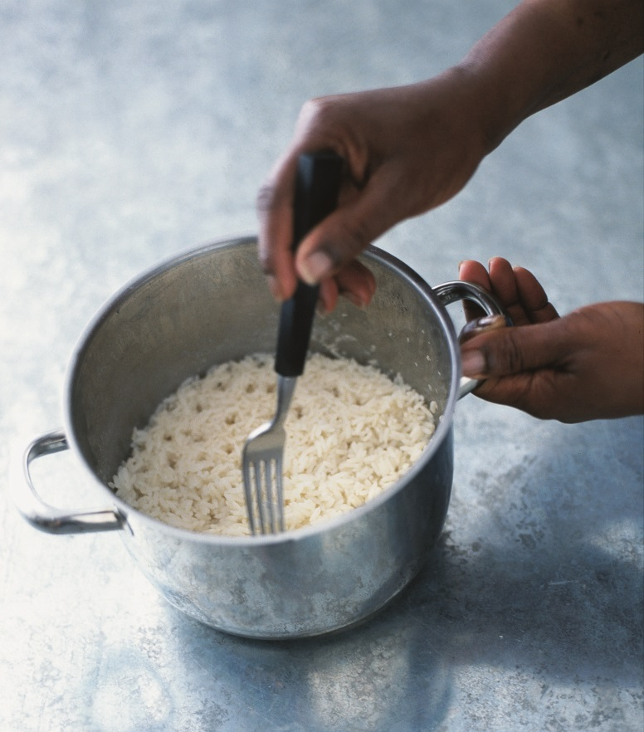
SIMMERING/STEAMING METHOD
Simmering/steaming can be done in
a pot on the stove, in a hotel pan in the oven, or in a rice cooker.
Key Tips:
Appropriate for all types of rice.
Use measured amount of liquid and rice to ensure proper texture of each rice type.
Simmer gently for evenly cooked grains.
Absorb all cooking liquid into rice to retain water-soluble nutrients.
Can vary equipment to suit needs.
For long grain rice, fluff with fork for separate grains; for moist, clingy texture of medium or short grain rice, fluffing with fork is NOT necessary.

Slide 12
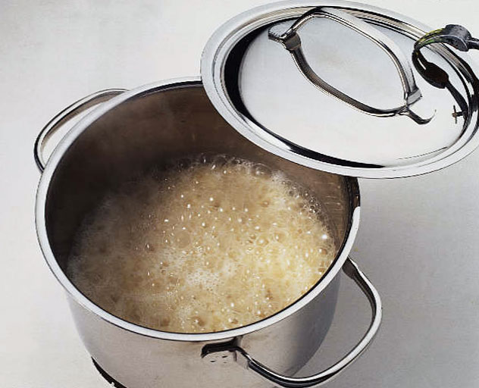
SIMMERING/STEAMING METHOD
Stove Top
Steps:
Combine water, rice and salt in a heavy pot; bring to a boil.
Cover the pot and simmer over low heat for 15-20 minutes, until is rice tender and water is absorbed.
Remove from heat; let stand 5 minutes. Fluff with a fork to help release steam.

Slide 13
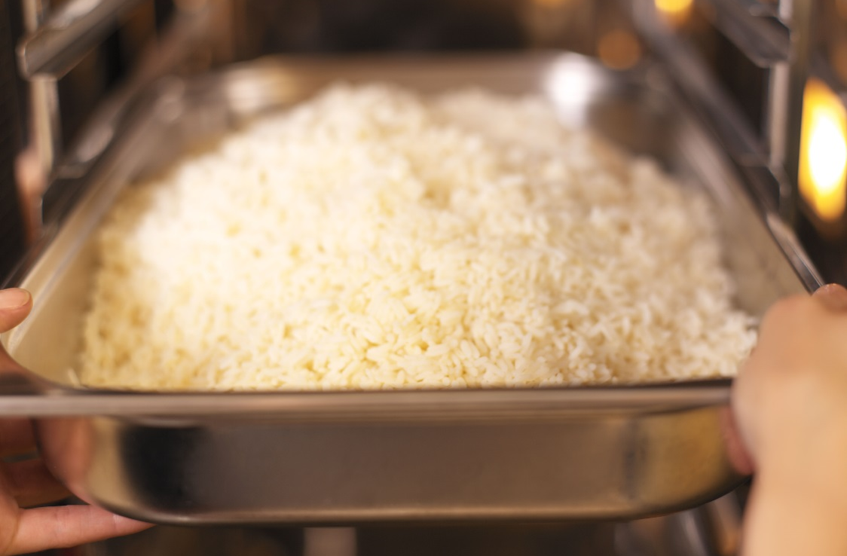
SIMMERING/STEAMING METHOD
Oven
Steps:
Combine rice and salt in a hotel pan placed near the oven. Add boiling water and stir.
Cover pan and place in a preheated 350°F oven.
Bake 30-40 minutes, until rice is tender and water absorbed.
Remove pan from oven; let stand 5 minutes. Remove cover and fluff with fork.
NOTE: To use a commercial steamer follow the steps above, except do not cover the pan. Rice is cooked in about half the time.

Slide 14
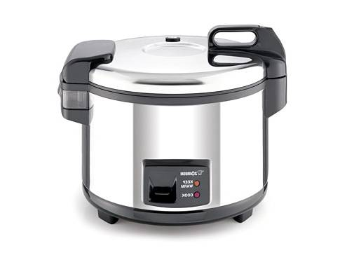
SIMMERING/STEAMING METHOD
Rice Cookers
Easy to use & foolproof, producing a consistent product.
  Thermostat sensor cooks rice the right amount of time, every time
When all water absorbed, automatically converts to “warm setting” to keep rice hot without overcooking it.
Cookers are insulated and sealed, so ratio of water to rice may be slightly lower than in other cooking methods.
  For best results, follow directions of rice cooker manufacturer

Slide 15
PILAF METHOD
Begins by sautéing rice in butter or oil, often with herbs or aromatic vegetables and then adding a measured amount of flavorful liquid for simmering.
Key Tips:
Keep heat low when sautéing to release maximum flavor without browning.
Coat rice with “fat” and toast to desired level before adding liquid.
Separate grains helps pilaf hold well.
Long grain white or brown rice popular choices, with wild rice a nice addition.
Flavor easily varied with change of liquid, aromatic rice & additional ingredients.

Slide 16
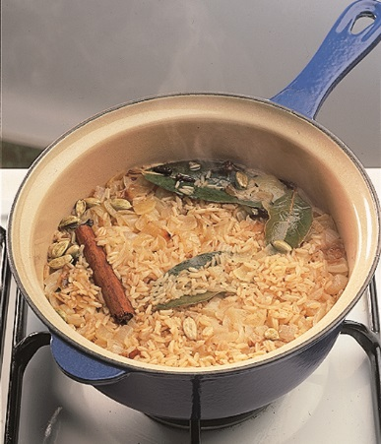
PILAF METHOD
Stove Top
Steps:
Melt butter in saucepan over medium-low heat; add onion, cover pan and cook until onion translucent.
Add rice, stir to coat with butter and sauté briefly to lightly toast rice.
Add stock, stir to moisten rice and bring to simmer.
Cover pot and simmer over low heat 15-20 minutes until rice is tender and liquid is absorbed.
Remove from heat; let stand 5 minutes. Fluff with a fork.

Slide 17
PILAF METHOD
Oven
Steps:
Melt butter in oven-proof saucepan over medium-low heat; add onion, cover pan and cook until onion translucent.
Add rice, stir to coat with butter and sauté briefly to lightly toast rice.
Add stock, stir to moisten rice and bring to simmer.
Cover pot and place in a 350°F oven for 30-40 minutes until rice is tender and liquid is absorbed.
Remove from oven; let stand 5 minutes. Fluff with a fork.

Slide 18
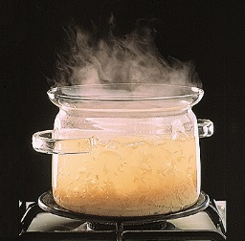
BOILING METHOD
Produces tender rice grains completely separate and not sticky; but loss of water-soluble nutrients. Sometimes referred to as the “pasta” method.
Key Tips:
Use large amount of liquid.
About 1 gallon per pound of rice.
Bring to vigorous boil before adding rice.
Drain water after desired texture is reached.
Cooked rice can be used immediately or rinsed with cool water for later use.
Ideal rice for soups and salads.

Slide 19
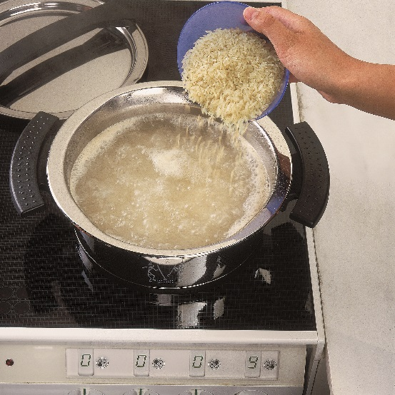
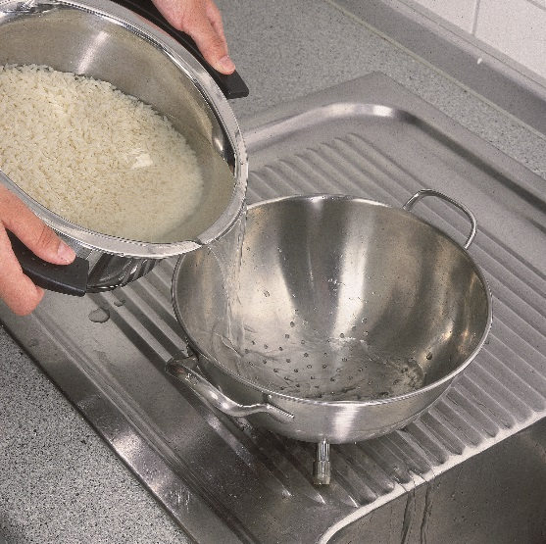
BOILING METHOD
Stove Top
Steps:
Determine the amount of rice to be cooked.
Combine water and salt in a large pot and bring to rapid boil.
Add rice, stir, cover and return to boil.
Uncover and boil until rice is tender.
Drain off water and serve.

Slide 20
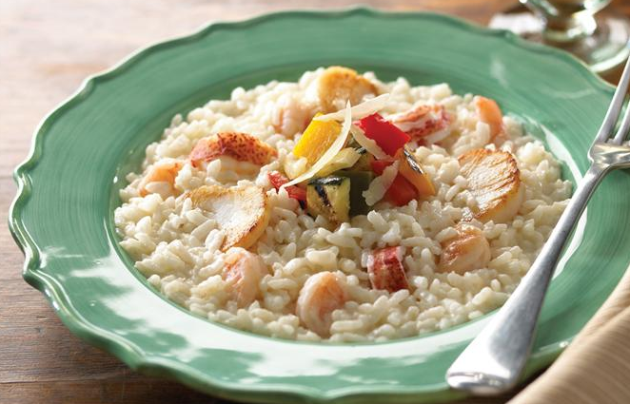
RISOTTO METHOD
Traditional Italian method for cooking medium grain or arborio rice; result is tender, creamy and flavorful.
Key Tips:
Made in an open pot or pan.
Constant stirring helps thicken liquid and retain rice texture.
Dish easily varied based on ingredients used while cooking or garnished just before serving.
For best consistency, cook to order.

Slide 21
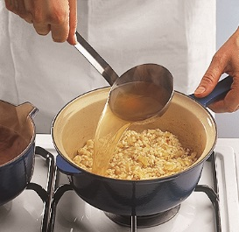
RISOTTO METHOD
Stove Top
Steps:
Bring stock to a simmer; keep hot.
In a heavy saucepan, melt butter/oil.
Add aromatic ingredients and cook over medium-low heat.
Add rice and stir to coat with butter.
Add a portion (1/3 or less) of hot stock to rice, stir frequently
until stock is absorbed.
Continue to add portions of stock when previous liquid is absorbed, stirring often; repeat until rice is slightly firm to the bite and creamy consistency.
Finish risotto with butter and grated cheese. Serve immediately.

Slide 22
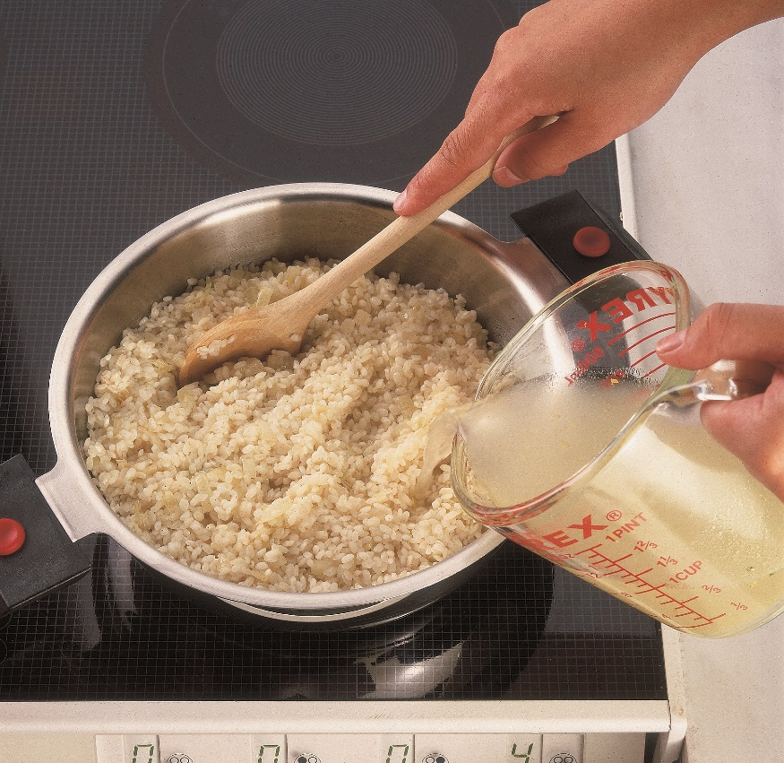
“RISOTTO TO ORDER” TIP
Ideal for busy foodservice operations, especially if pre-prepping ingredients before service.
Follow the basic directions, but stop cooking before the last addition of stock. Transfer rice to shallow pan and spread evenly; cover and refrigerate.
For service, reheat a portion of the chilled risotto with remaining stock, stirring constantly until creamy and tender. Finish as desired and serve immediately.

Slide 23
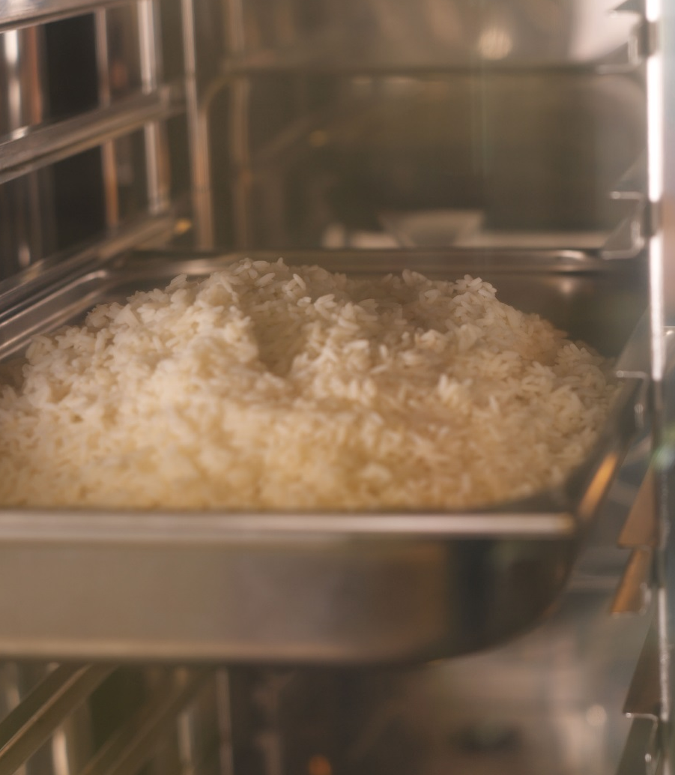
HOLDING & STORING COOKED RICE
Hold hot rice in a steam table above 140°F (60°C).
To store, cool rice ASAP by transferring to a shallow pan.
    Cool hot rice to 70°F (21°C) within 2 hours and then to 40°F (4°C) within the next 4 hours.
Always wrap and date containers of cooked rice prior to storing in refrigerator.
    Cooked rice can be stored up to 3 days.

Slide 24

OTHER FACTORS AFFECTING COOKING
Pots and Pans
    Shallow, wide pans cook rice faster and more evenly.
    Lid seal affects cooking time and moisture loss.
Ovens
    Calibration and recovery time affect cooking time.
Batch Size
    Larger batches take longer to cook and may require less liquid.
Rinsing
    Not recommended for almost all rice types; will cause nutrient loss in enriched rice.
    If rice is rinsed or soaked (ex. sushi rice), it may require slightly less liquid and shorter cooking time.

Slide 25

USA Rice
2101 Wilson Boulevard, Suite 610
Arlington, VA 22201
703-236-2300
www.thinkrice.com

