Slide 1
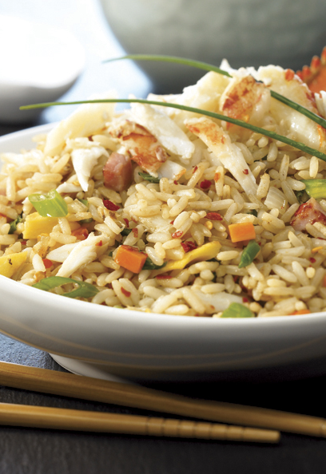
RICE IN CUISINE
International Recipes

Slide 2
RICE’S VERSATILITY ON THE MENU
Breakfast | Enhanced with cinnamon and fruit for a nutritious alternative to oatmeal or cereal
Soups & Stews | Garnish, thickener or primary starch component in stews
Appetizers | Risotto, sushi, arancini, rice cakes and more
Main Courses | Paella, arroz con pollo, jambalaya, rice bowls, stirfrys and more; stuffings; ideal for vegetarian meals
Side Dishes | Accompaniment to meat, poultry, seafood and vegetables
Salads | Rice salads feature vegetables, fruits and proteins; makes great fillings for wrap sandwiches
Desserts | Rice puddings, Asian desserts and more

Slide 3
INTERNATIONAL RICE DISHES
Arancini (Italian)
Arroz con Pollo (Latin American)
Arroz con Gandules (Caribbean)
Avgolemono (Greek)
Biryani (Indochina)
Calas (American)
Congee (Chinese/Asian)
Dolmas (Greek/Turkish)
Etouffeé (American)
Fried Rice (Chinese, Thai)
Gumbo (American)
Jambalaya (American)
Moros y Cristianos (Cuban)
Paella (Spanish)
Pilau (Middle East)
Red Beans & Rice (American)
Rice Croquettes (French)
Risotto (Italian)
Suppli (Italian)
Sushi (Japanese)

Slide 4
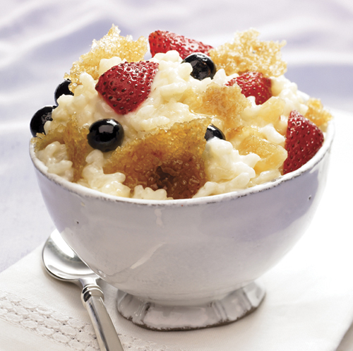
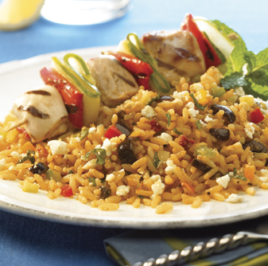
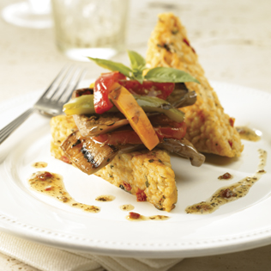
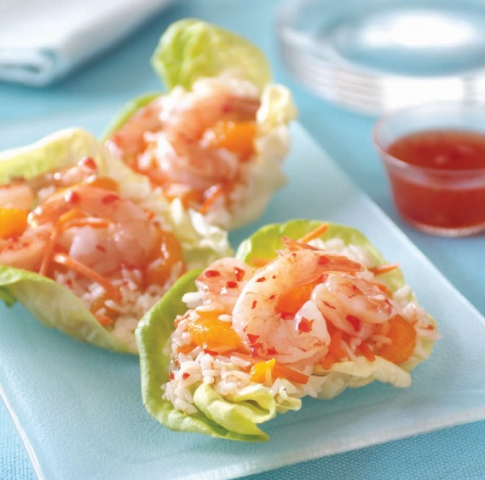
INTERNATIONAL RECIPES
A sampling of favorites from around the globe

Slide 5
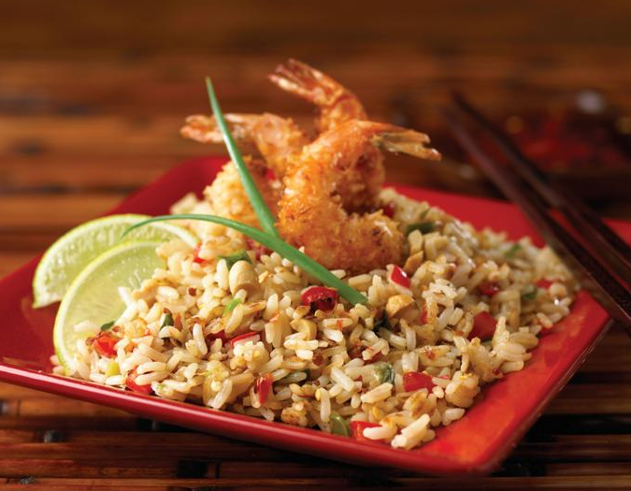
FRIED RICE
A versatile delicious meal that transforms leftovers into profits;
a good addition for every chef’s recipe repertoire.
Customize with vegetables or proteins on hand.
Make to order, serve from a steamtable or use on a demo station.

Slide 6
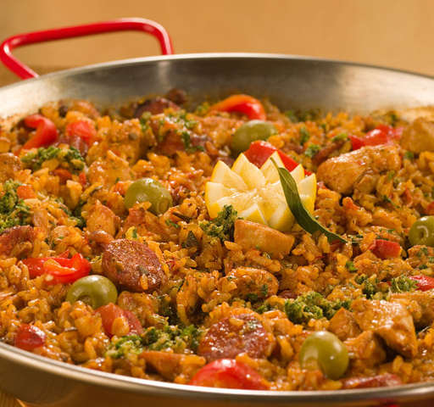
PAELLA
Saffron-tinted specialty from southern Spain is impressive and surprisingly easy to assemble.
Use the basic recipe as a template, substituting your choice of meat, seafood, vegetables and seasonings.
Prepare in a large pan or make individual servings to order.

Slide 7
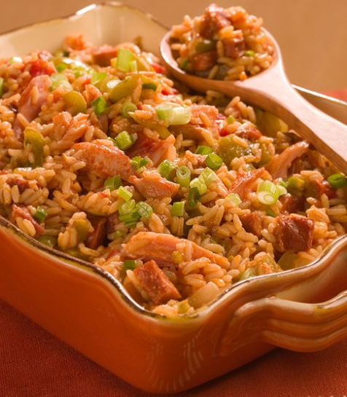
JAMBALAYA
Louisiana dish of rice, pork, ham, sausage, seafood and seasonings.
One of the most famous Creole/Cajun culinary creations.
Ideal for customization and showcasing creativity.

Slide 8
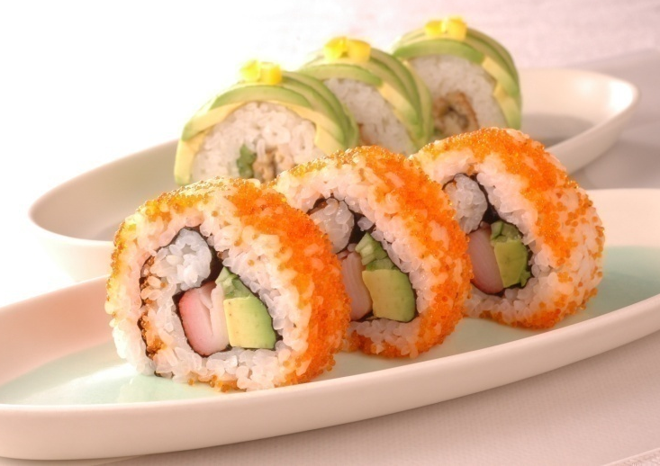
SUSHI
Made with steamed rice, rice vinegar & garnished with colorful, flavorful ingredients.
Maki is the Japanese word for rolled sushi.
Quality of sushi depends on properly prepared rice and freshness of ingredients.
Nearly all sushi consumed in the U.S. is made with U.S.-grown rice!

Slide 9
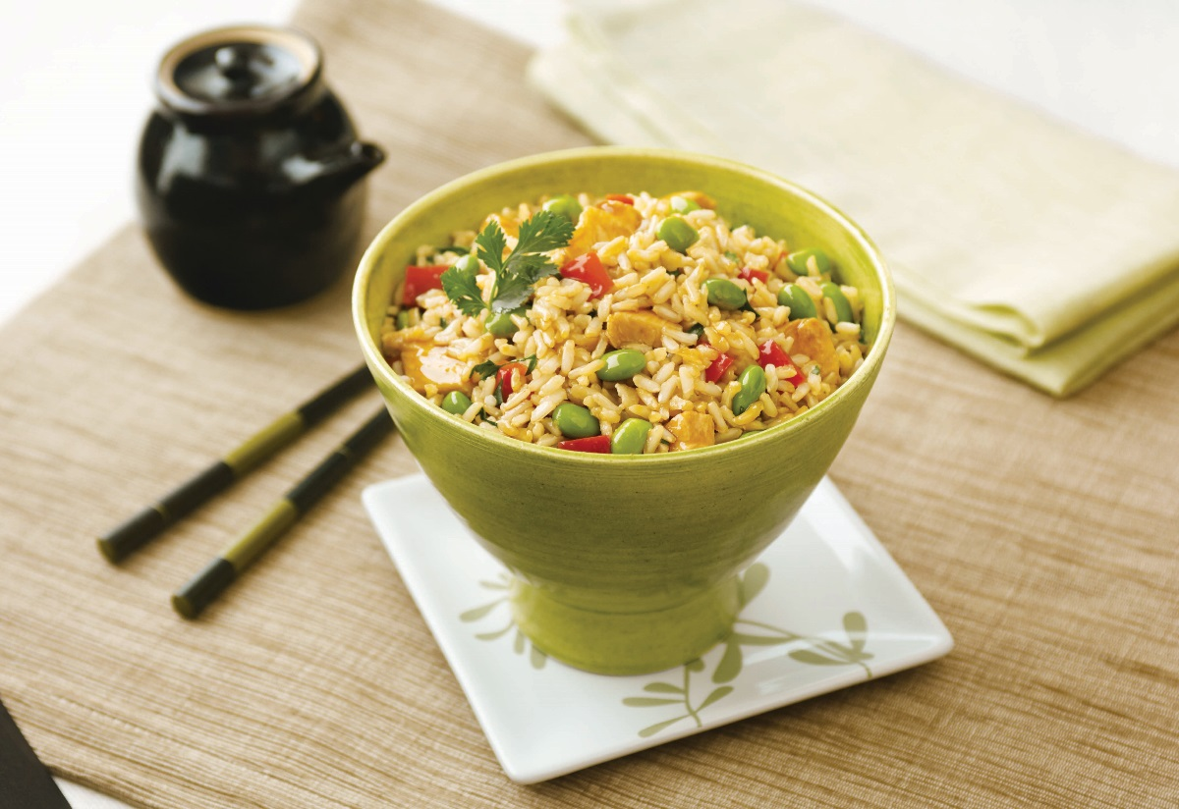
RICE BOWLS
Showcase rice as a versatile flavor carrier; transform
on-hand ingredients into savory, all-in-one meals.
  Benefits include:
  Use any rice type.
  Easy to prepare and serve.
  Perfect for vegetarian menu options.
  Ideal for dining in or carry-out service.
  Rice Bowl stations allow diners to customize their meals.
  Great way to control food cost.

Slide 10
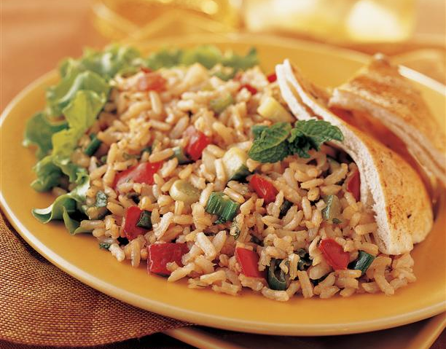
BROWN RICE TABBOULEH
Middle Eastern salad traditionally made from bulgur wheat.
Use with brown rice for a new gluten-free variation.
Ideal vegetarian main dish, salad or side.
Add feta cheese and kalamata olives for a Greek flair.

Slide 11
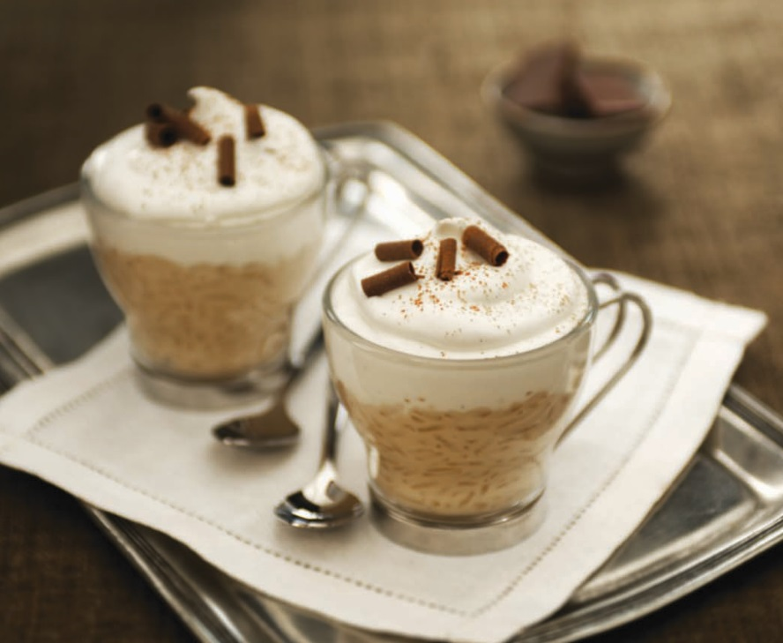
RICE PUDDING
A classic and popular dessert.
Adds versatility to the menu with unlimited flavors and garnishes.
Can be prepared using stove top or oven method.
To help with food costs, make using leftover rice.

Slide 12
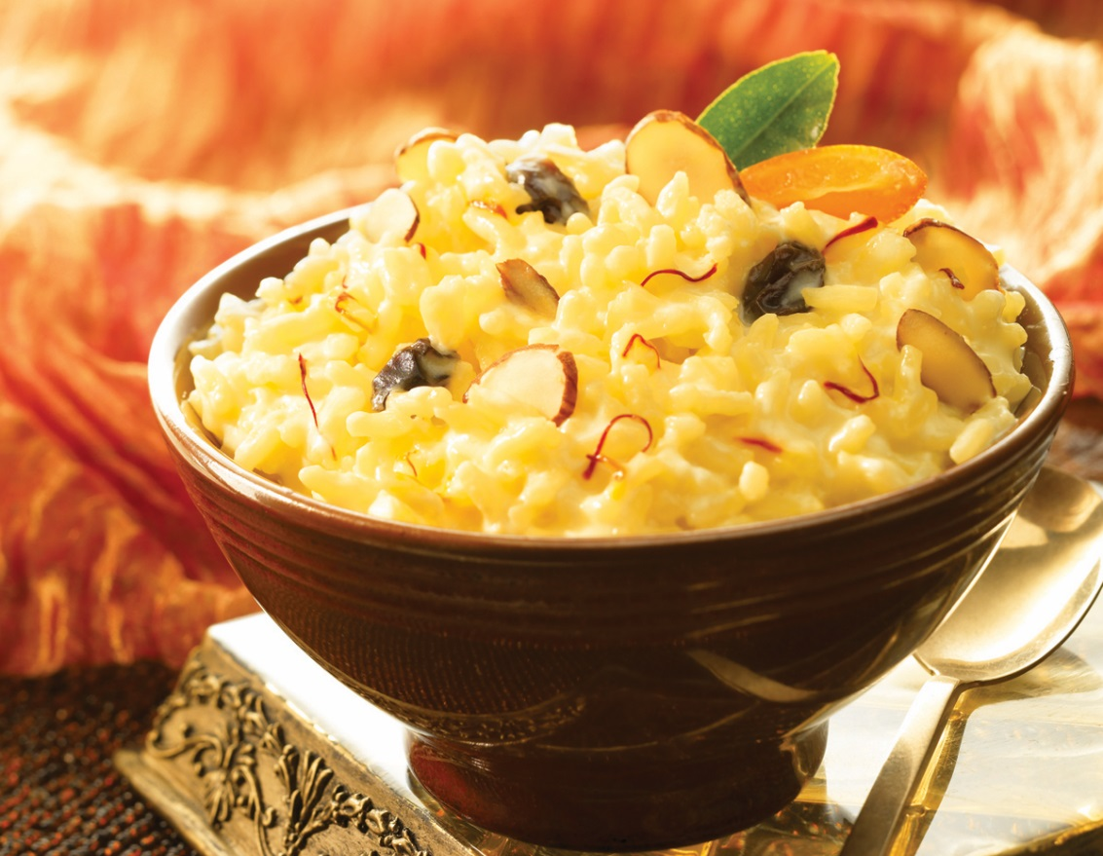
RICE PUDDING VERSATILITY
Be as creative as possible by adding flavors, fruits, berries, chocolate.
Try these ideas for a starter:
    Cappuccino Rice Pudding Cups
    Cardamom Saffron Rice Pudding
    Lemon-Berry Rice Pudding
    White Chocolate Rice Pudding with Raspberry Sauce
    Praline Pumpkin Rice Pudding
    Maya-Mediterranean Chocolate Rice Pudding
    Crepes Stuffed with Grand Marnier Rice Pudding

Slide 13

USA Rice
2101 Wilson Boulevard, Suite 610
Arlington, VA 22201
703-236-2300
www.thinkrice.com

